Slide 1




CSS Layout
Arrangement and Positioning of the HTML Elements
Web Fundamentals
SoftUni Team
Technical Trainers
Software University
http://softuni.bg

Slide 2


Table of Contents
Width and Height
Margins and Paddings
Overflow (Scroll, Hidden)
Display (Block, Inline-Block, …)
Visibility (Visible, Hidden)
The Box Model
Positioning (Absolute, Relative, Static)
Floating Elements and Float Clearing

Slide 3
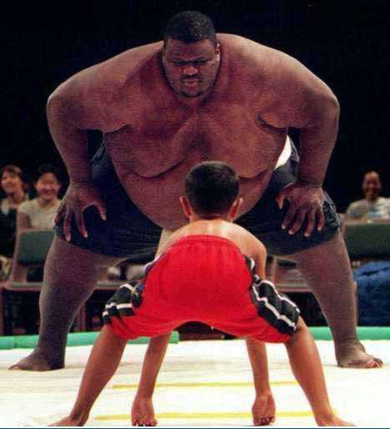
Width and Height

Slide 4
Width
width – defines a value for the width of element, e.g. 200px
width applies only for block elements
Their with is 100% by default (the width of their parent)
The width of inline elements is the width of their content
min-width – defines the minimal width
min-width overrides width if (width < min-width)
max-width – defines the maximal width
max-width overrides width if (width > max-width)

Slide 5
Width Values
The values of the width / height properties are numerical:
Pixels (px)
Centimeters (cm)
Or percentages (%)
A percent of the available width (of the parent container)
Set the max-width to 100% to scale-down images (for tablets)
img {
max-width: 100%;
}

Slide 6

Width
Live Demo

Slide 7
Height
height – defines the height of element, e.g. 100px
height applies only on block elements
The height of inline elements is the height of their content
min-height – defines the minimal height
min-height overrides height
max-height – defines the maximal height
max-height overrides height

Slide 8

Height
Live Demo

Slide 9
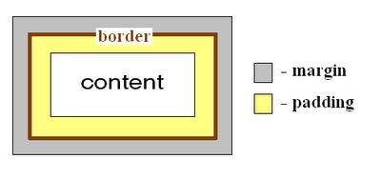
Margins and Paddings

Slide 10
Margin and Padding
margin and padding define the spacing around the element
margin is the spacing outside of the border
padding is the spacing between the border and the content
Numerical value, e.g. 10px or -5px
Can be defined for each of the four sides separately:
margin-top, padding-left, …
Sometimes vertical margins of adjacent elements may collapse
E.g. adjacent paragraphs / parent-child elements / empty blocks

Slide 11
Margin and Padding: Short Rules
margin: 5px;
Sets all four sides to have margin of 5px;
margin: 10px 20px;
top and bottom to 10px, left and right to 20px;
margin: 5px 3px 8px;
top 5px, left/right 3px, bottom 8px
margin: 1px 3px 5px 7px;
top, right, bottom, left (clockwise from top)
Same for padding

Slide 12

Margin and Padding
Live Demo

Slide 13
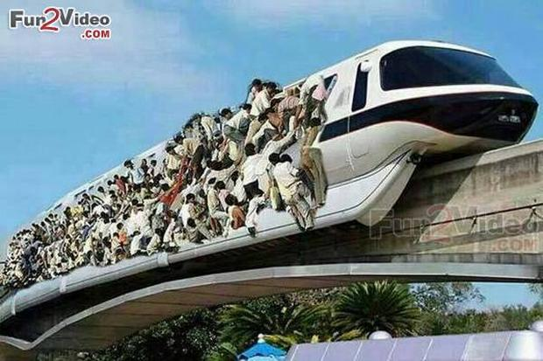
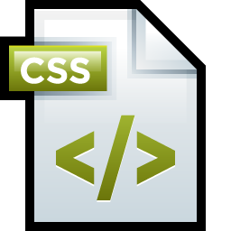

Overflow

Slide 14
Overflow
Defines the behavior of element when content needs more space than the available
overflow values:
visible (default) – content spills out of the element
auto – show scrollbars if needed
scroll – always show scrollbars
hidden – any content that cannot fit is clipped

Slide 15

Overflow
Live Demo

Slide 16
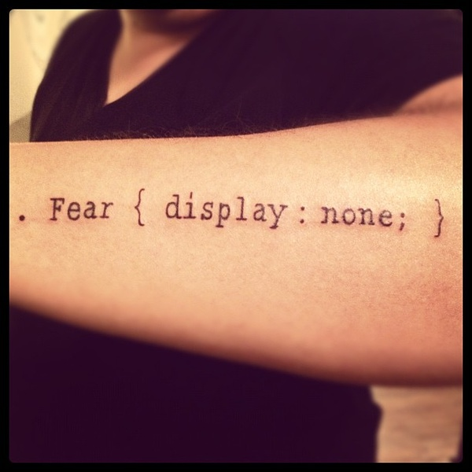
Display

Slide 17
Display
Controls the display of the element
Defines the way it is rendered and if breaks should be placed before and after the element
inline: no breaks are placed before and after
Like typical <span> is element
The element's height and width depend on the size of the content
block: breaks are placed before AND after the element
Like typical <div> is a block element
Height and width may not depend on the size of the content

Slide 18
Display
inline-block
No breaks are placed before and after (like inline)
Height and width can be applied (like in block elements)
table, table-row, table-cell
The elements are arranged in a table-like layout
none
The element is hidden and its dimensions are not used to calculate the surrounding elements rendering
Differs from visibility: hidden

Slide 19

Display
Live Demo

Slide 20
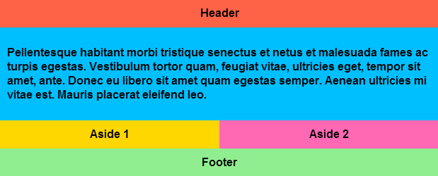
Flexbox
The Magic of display:flex

Slide 21
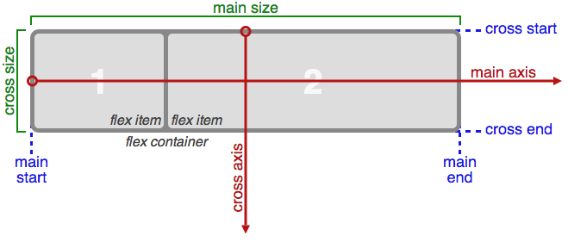
Flexbox Basics
Flexbox (Flexible layout) - efficient way to lay out, align and distribute space among items in a container
Gives the container ability to alter its items' width/height/order to best fill the available space
main axis - primary axis along which flex items are laid out
Horizontal or vertical - depends on flex-direction property
main size - flex items' width or height, whichever is in the main dimension
main-start / main-end - flex items are placed within the container starting from main-start and going to main-end

Slide 22
Flexbox Basics (2)
cross axis - perpendicular to the main axis
cross size - the width or height of a flex item, whichever is in the cross dimension
cross-start / cross-end - Flex lines are filled with items and placed into the container starting on the cross-start side of the flex container and going toward the cross-end side.

Slide 23
Flex - container properties
display: flex - defines a flex container
flex-direction - primarily laying out either in horizontal rows or vertical columns
row: left to right (ltr) right to left (rtl)
row-reverse: right to left (ltr) left to right (rtl)
column: same as row, but top to bottom
column-reverse: same as row-reverse but bottom to top
flex-wrap - wrap as needed with this property
Nowrap: single-line / left to right (ltr) right to left (rtl)
Wrap: multi-line / left to right (ltr) right to left (rtl)
Wrap-reverse: multi-line / right to left (ltr) left to right (rtl)
flex-flow - shorthand for (flex-direction) & (flex-wrap) properties

Slide 24
Flex - container properties (2)
justify-content – alignment along the main axis
align-content – alignment along the cross axis
justify-content and align-content property values
flex-start: lines packed to the start of the container
flex-end: lines packed to the end of the container
center: lines packed to the center of the container
space-between: first-to the start & last-to the end of the section
space-around: equal space between them
align-items – how flex items are laid along the cross axis on the current line
flex-start | flex-end | center | baseline | stretch

Slide 25
Flex – item properties
default alignment (or the one specified by align-items) to be overridden for individual flex items.
order - order in which flex items appear in the flex container
<number> // default 0
flex-grow - defines the ability of a flex item to grow if necessary
<number> // default 0
flex-shrink - defines the ability of a flex item to shrink if necessary
<number> // default 1
flex-basis - defines the default size of an element before the remaining space is distributed
<length> // default auto
flex – shorthand for (flex-grow) & (flex-shrink) & (flex-basis)
align-self – default alignment to be overridden for individual flex item

Slide 26
Flexbox
Live Demo

Slide 27
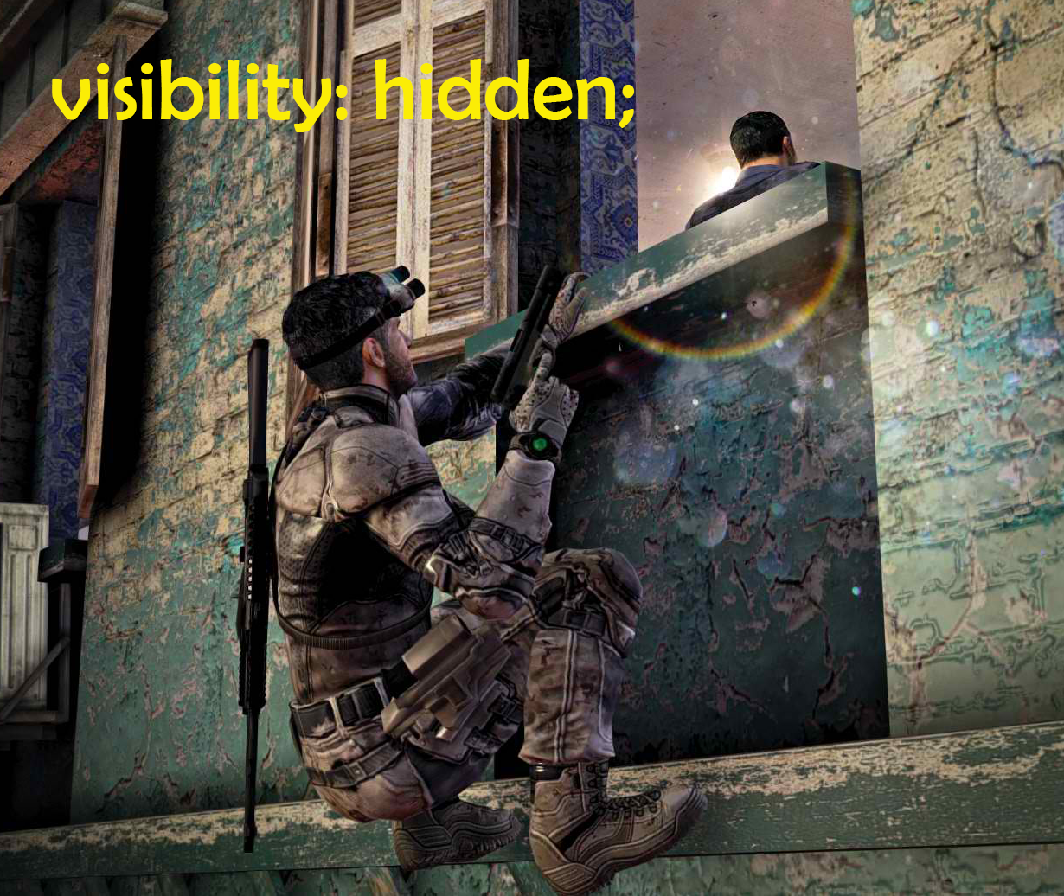
Visibility

Slide 28
Visibility
Determines whether the element is visible
Visibility values:
visible
The element is rendered normally
hidden
The element is not rendered, but still occupies place on the page (similar to opacity:0)
collapse
hides rows or columns of a table

Slide 29
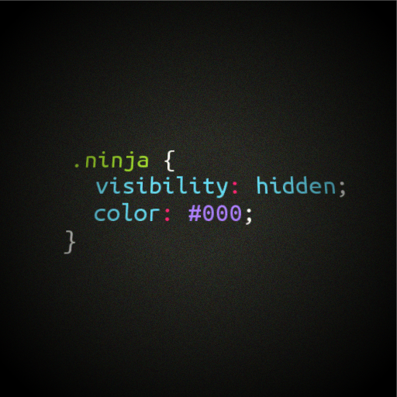
Visibility
Live Demo

Slide 30
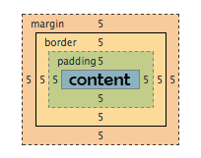
The Box Model

Slide 31
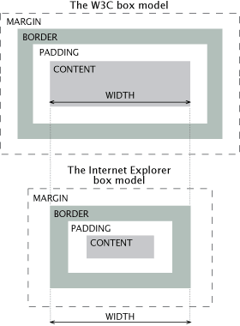
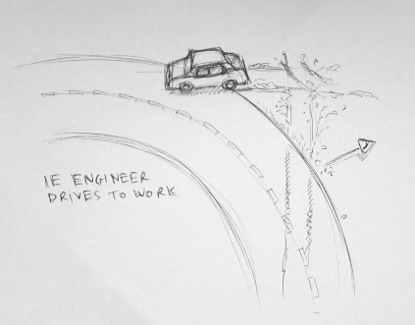
IE Quirks Mode
When using quirks mode (pages with no DOCTYPE or with a HTML 4 Transitional DOCTYPE)
Internet Explorer violates the box model!

Slide 32
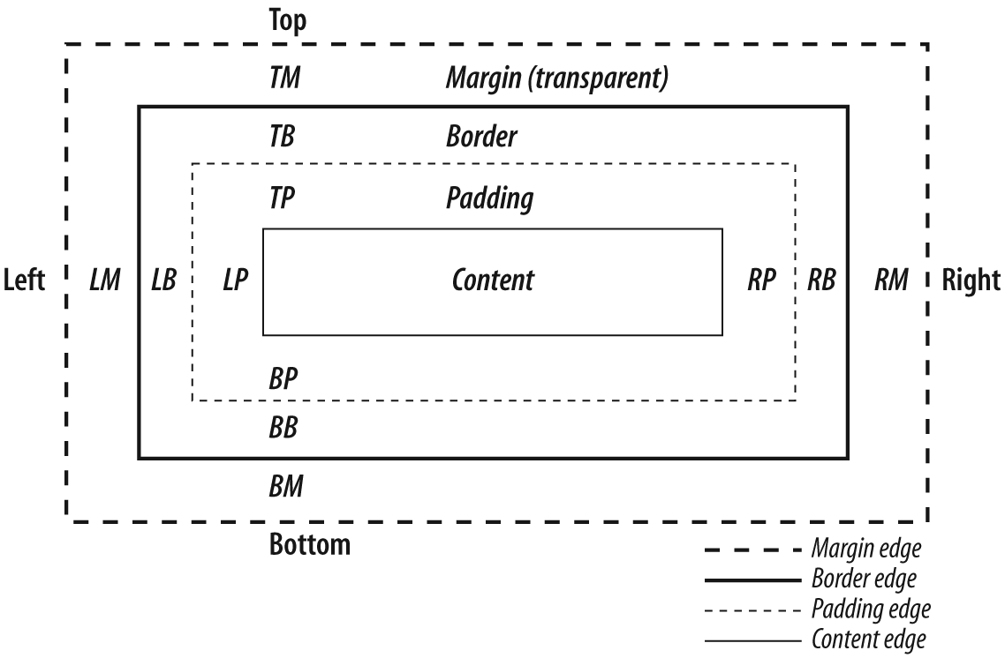
The Box Model

Slide 33
CSS3 Box-Sizing
Determine whether you want an element to render it's borders and padding within its specified width, or outside of it.
Possible values:
box-sizing: content-box (default) box width: 288 pixels + 10 pixels padding and 1 pixel border on each side = 310 pixels
box-sizing: border-box box width: 300 pixels, including padding and borders

Slide 34
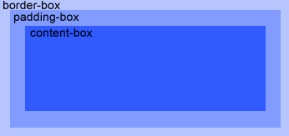
CSS3 Box-Sizing (Example)
Example: Box with a total width of 300px (including paddings and borders)
width: 300px;
border: 1px solid black;
padding: 5px;
/* Firefox */
-moz-box-sizing: border-box;
/* WebKit */
-webkit-box-sizing: border-box;
/* Opera 9.5+, Google Chrome */
box-sizing: border-box;

Slide 35
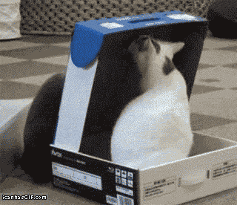
Box Model
Live Demo

Slide 36
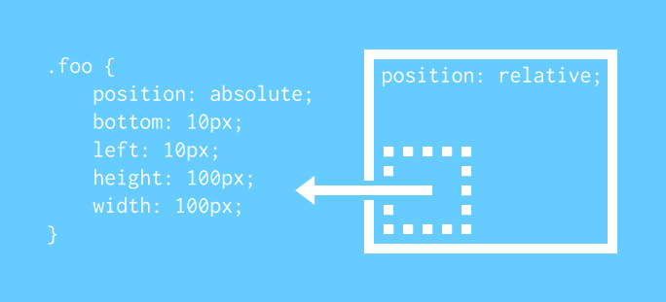
Positioning

Slide 37
Positioning
position: defines the positioning of the element in the page content flow
The value is one of:
static (default)
relative – relative position according to where the element would appear with static position
absolute – position according to the innermost positioned parent element
fixed – same as absolute, but ignores page scrolling

Slide 38
Positioning
Margin VS relative positioning
Fixed and absolutely positioned elements do not influence the page normal flow and usually stay on top of other elements
Their position and size is ignored when calculating the size of parent element or position of surrounding elements
Overlaid according to their z-index
Inline fixed or absolutely positioned elements can apply height like block-level elements

Slide 39
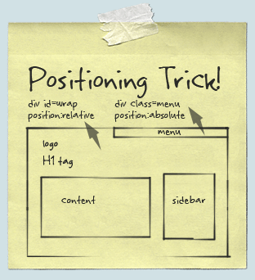
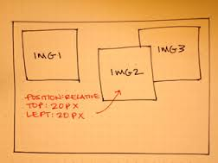
Positioning
top, left, bottom, right: specifies offset of absolute/fixed/relative positioned element as numerical values
z-index : specifies the stack level of positioned elements
Understanding stacking context
Each positioned element creates a stacking context.
Elements in different stacking contexts are overlapped according to the stacking order of their containers. For example, there is no way for #A1 and #A2 (children of #A) to be placed over #B without increasing the z-index of #A.

Slide 40
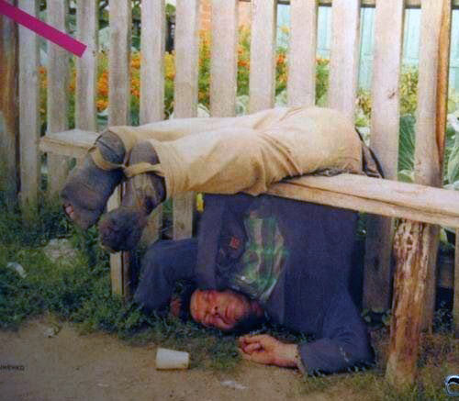
Positioning
Live Demo

Slide 41
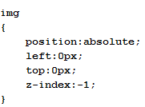
Vertical Align
What it actually does?
vertical-align only applies to inline or inline-block elements
Affects the alignment of the element itself, not its contents
For table cells, the alignment affects the cell contents, not the cell
Sets the vertical-alignment of an inline element, according to the line height
What it does NOT do?
All the elements inside the vertically aligned element change their vertical position
Values: baseline, sub, super, top, text-top, middle, bottom, text-bottom or numeric
http://www.impressivewebs.com/css-vertical-align/

Slide 42
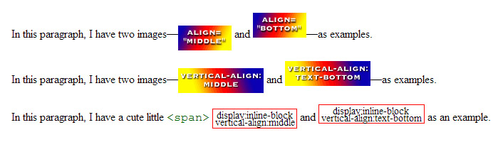
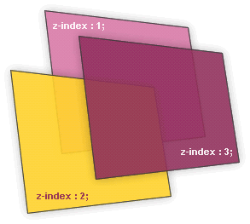
Alignment and Z-Index
Live Demo

Slide 43
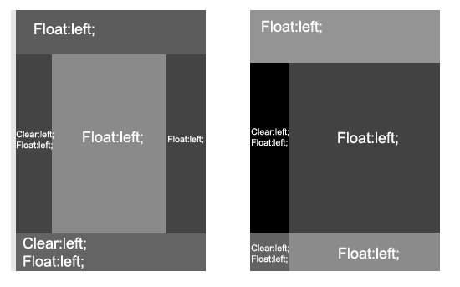
Floating

Slide 44
Float
float: the element “floats” to one side
left: places the element on the left and following content on the right
right: places the element on the right and following content on the left
floated elements should come before the content that will wrap around them in the code
margins of floated elements do not collapse
floated inline elements can apply height

Slide 45
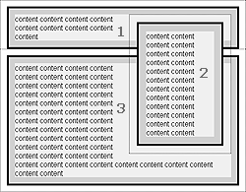
How Floated Elements are Positioned ?

Slide 46
Clear
Sets the sides of the element where other floating elements are NOT allowed
Used to "drop" elements below floated ones or expand a container, which contains only floated children
Possible values: left, right, both
Clearing floats
Clear using pseudo-class :after
Additional element (<div>) with a clear style
Deprecated – semantically unused <div>

Slide 47
Clear
Clearing floats (continued)
:after { content: ""; display: block; clear: both; height: 0; }
Triggering hasLayout in IE expands a container of floated elements
zoom: 1
.clearfix {
zoom:1;}
.clearfix:after {
content: "";
display: block;
clear: both;
height: 0; }

Slide 48

Floating Elements
Live Demo

Slide 49

Summary
Width and Height - max/min width and height in numerical values
Margin and Padding
Overflow - visible, auto, scroll, hidden
Display - block, inline, inline-block, table, none
Flexbox – layout module
Visibility - visible, hidden
Box model – content-box, border-box
Positioning – absolute, relative, fixed
Float - left, right, clear
Z-Index

Slide 50








CSS Layout
https://softuni.bg/courses/web-fundamentals/

Slide 51
License
This course (slides, examples, demos, videos, homework, etc.) is licensed under the "Creative Commons Attribution-NonCommercial-ShareAlike 4.0 International" license
Attribution: this work may contain portions from
"HTML Basics" course by Telerik Academy under CC-BY-NC-SA license
"CSS Styling" course by Telerik Academy under CC-BY-NC-SA license

Slide 52





Free Trainings @ Software University
Software University Foundation – softuni.org
Software University – High-Quality Education, Profession and Job for Software Developers
softuni.bg
Software University @ Facebook
facebook.com/SoftwareUniversity
Software University @ YouTube
youtube.com/SoftwareUniversity
Software University Forums – forum.softuni.bg

